Slide 1



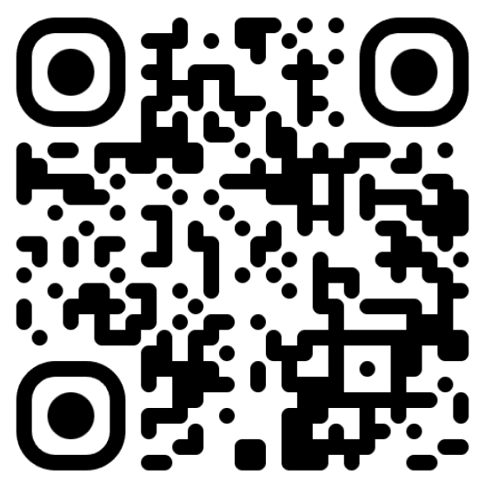
ABP Community Talks 2025.10
Building AI-Powered .NET Apps with ABP & Microsoft Agent Framework

Slide 2
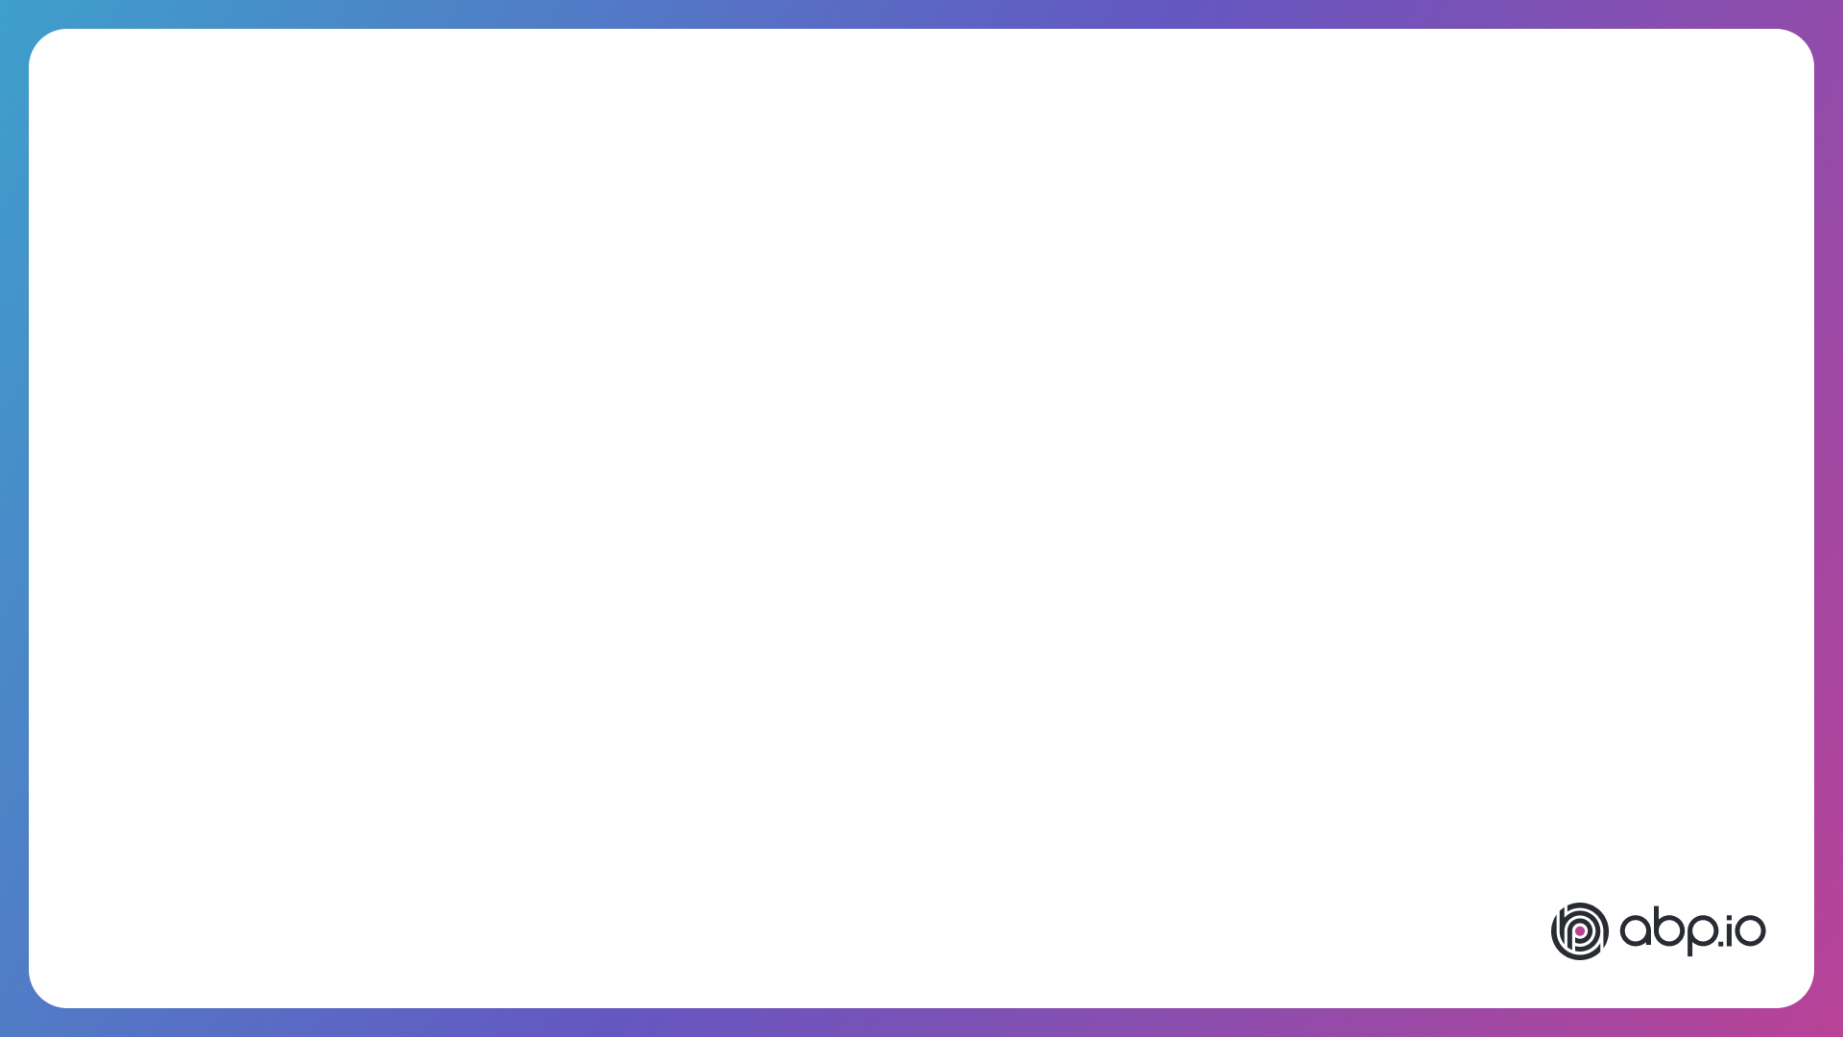
Agenda
Overall
  Microsoft’s AI libraries/frameworks
  What ABP Team is doing?
The Microsoft Agent Framework by Engin Veske
ABP AI Management Module by Enis Necipoğlu
QA – ask your questions!

Slide 3
Microsoft AI Libraries/Frameworks
Microsoft.Extensions.AI
Semantic Kernel
AutoGen
Agent Framework

Slide 4
Microsoft.Extensions.AI
The Foundation Layer
Abstractions and fundamental implementations for models, prompts, chat and embeddings
Dependency Injection support
Simple middleware system for extensibility
Other libraries use this as the base

Slide 5
Semantic Kernel
The Application Framework
Function orchestration
Connectors/plugins for external systems
Memory abstractions (vector stores, retrieval)
Planners, task execution, pipelines
High-level patterns like RAG, agent ↔ tool interactions, agent orchestration / workflows

Slide 6
AutoGen
Multi-Agent Coordination
Agent classes (chat agent, tool agent, etc)
Conversation orchestration
Patterns like round-robin, group chats, delegation, function calling, and human-in-the-loop
As October 2025, it enters to maintanence phase – The Agent Framework is recommended now

Slide 7
Microsoft Agent Framework
The Future
Use Microsoft.Extensions.AI as the underlying model interface
Gets the best practices from Semantic Kernel orchestration and AutoGen’s conversational agents

Slide 8
Relations of MS AI Libraries
Agent Framework
Migrating
Migrating
Semantic Kernel
(maintainance mode)
AutoGen
(maintainance mode)
Partially
Implements
Implements
Microsoft.Extensions.AI

Slide 9
AI for ABP Developers
Everything you can build with .NET is easier with the ABP Framework – You can use any AI Framework in your ABP applications
The new Volo.Abp.AI NuGet Package
  Workspaces: Manage multiple AI configuration in a single application
  Modularity: Configure and use AI in a modular application
AI Management Module
  Centralize and visualize how to managet and test AI configuration
  Provide a AI usage model for distributed systems

Slide 10
TODO
TODO

